Slide 1
If you are catching up on the training, listen along for any extra key points!
Clubs and Societies committee training

Slide 2
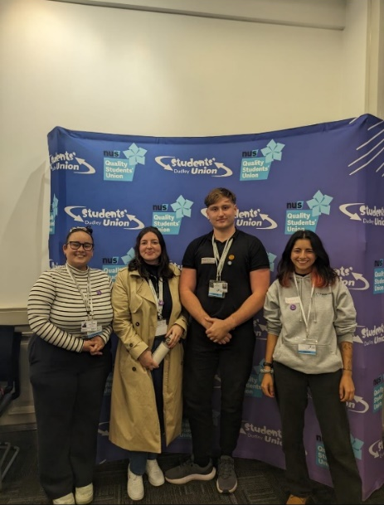
Our Team
Staff
SU Manager
Elected students
SU President
Representation Coordinator
Activities Coordinator
Engagement Officer
Wellbeing and Inclusivity Officer
Clubs and Societies Officer
Student Reps and Opinion hub
Clubs and society committee members
Liberation Representatives
Volunteers

Slide 3
What are we doing here?!
Icebreaker!
1
Understand what’s involved with running your club
2
Understand the key documents and processes involved with running a Society
3
Plan activities and events for the next year
4
Demonstrate your knowledge (quiz!)
5

Slide 4
Icebreaker
0
45
15
30
Notes:
1 minute – talk to ONE person in the room you don’t already know and find out their name, club, committee role, and course – build a club community!

Slide 5
Running your club or society
The Clubs and Societies Officer is your main point of contact and is here to help you, so always ask if you’re not sure!
You will need (as a minimum): a chair, a treasurer and a secretary…
The SU provides a £200 start up fund and you will need to decide if members need to pay a membership fee to join your club or society
The SU will provide you with guidance on:
Managing your finances
Organising events
Booking transport
Fundraising
Running your AGM / Handover

Slide 6
Committee Roles
Any questions?
Elected via votes each year!
Chair
Oversee and represent the society as a whole (including student council)
Ensure the society is running fairly and correctly
Organise events, activities, socials, trips alongside the other committee members
Have regular and consistent communication with the Clubs and Societies Officer
Secretary
Manage communications between the committee and members of the society
Organise timings and meeting when necessary (and take minutes at meetings)
Have a key role in organising events and activities alongside the other committee members
Treasurer
Manage the society’s finances and understand financial processes
Communicate with Students Union regarding memberships and when the society needs to spend money
Organise the memberships to be put on the online shop with the clubs and societies officer
Notes:
Each role is not exclusive to these points – generally you will work as a team and delegate between you but these are some guidelines.
Also, if you have interest you can have more committee positions if members want to be a bit more involved, for example, social media, events organiser, fundraising officer etc.
positions on committees are generally elected through voting however this depends on how many people want to run for each role. Your C&S Officer will help you with organising voting!

Slide 7
What we expect from you
YOU will be driving the direction and work of the club
Be responsive - please reply to emails we send you
Be considerate - we are here to support, rather than do - we need to support all societies equally
Use the information and resources provided via the C&S committees hub
Work together with the committee to succeed

Slide 8
What does a society do?
Hockey Club, Polo Club, and Clay Shooting Club: Train weekly and compete in the BUCS league throughout the year, offering students the chance to develop their skills and represent Hartpury in competitions.
Wildlife Society: Hosts weekly sessions where members watch wildlife documentaries and discuss topics related to conservation and animal behaviour, creating a space for like-minded students to connect.
Ag Society: Organises regular socials and is planning an exciting ski trip in March, providing members with opportunities to socialise and explore interests beyond campus.
Societies can run whichever activities the members want to participate in. Each society tends to be individual and different. Some examples…
You can do BIG events or regular small socials / activities – it’s up to you!
Each society runs differently and if you need help with deciding what the society would like to do then get in touch with your Clubs and Societies Officer.
If there’s crossover, why not collab?!

Slide 9
Core documents and meetings
Any questions?
Committee documents
C&S Code of Conduct / HSU Code of Conduct (NEW) – outlines behavioural expectations
Code of Practice (if applicable)
Committee member agreement form – have you signed?
Committee meetings
Regular committee meetings with C&S Officer
Club development meetings (you organise)
Student Council (3x per academic year) – CHAIRS only
AGM / handover in March - Opportunity to reflect on activity and plan for the following year
Notes:
Code of conduct & agreement form highlights behavioural expectations – representing Hartpury
Break before we go into the processes involved…

Slide 10
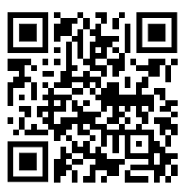
2 minutes
Read and sign the agreement form
Notes:
Volunteer Agreement | Hartpury Students Un

Slide 11
Processes to be aware of…
U18s procedure
Offsite visits process
Risk assessments
Transport processes
External speakers process
Finance
Fundraising
Social media

Slide 12
U18s Procedure
At HSU, we represent both College and University students. We encourage all C&S to be open to all students at Hartpury, where possible.
This means it is possible you will have under 18 members and will be responsible for ensuring their safety, in line with Hartpury’s core safeguarding policy.
Associated documents (available on the Committee Hub on SU website):
U18 membership consent form
U18 consent form (for external visits or high-risk activity)
U18 guidelines
Risk Assessment template
U18s procedure
Offsite visits
Risk Assessments
Transport
External Speakers
Finance
Fundraising
Social Media

Slide 13
U18s Procedure – key points
Any questions?
Please take time to read the guideline in full, but note the following key points:
U18 students should not be responsible for running an event
All U18s should inform you of their age at the point of joining, and only be accepted as a member once the membership consent form is signed by their parent / guardian. You will then need to inform the SU and send us a copy of the signed form.
When planning activities, ensure that you risk assess and determine where a DBS-checked member of staff should be present
U18 students are not permitted to attend overnight trips
A consent form must also be completed by parents / guardians for any HIGH-RISK activity or EXTERNAL trips
U18s procedure
Offsite visits
Risk Assessments
Transport
External Speakers
Finance
Fundraising
Social Media

Slide 14
Offsite Visits Process
For all external trips you will need to complete an offsite visits form at least 4 weeks beforehand. This will be reviewed by the SU team and, if necessary, will go to the Hartpury safeguarding committee for approval.
Associated documents (available on the Committee Hub on SU website):
Offsite visit form
U18 consent form (for external visits or high-risk activity)
Risk Assessment template
Transport request form
U18s procedure
Offsite visits
Risk Assessments
Transport
External Speakers
Finance
Fundraising
Social Media

Slide 15
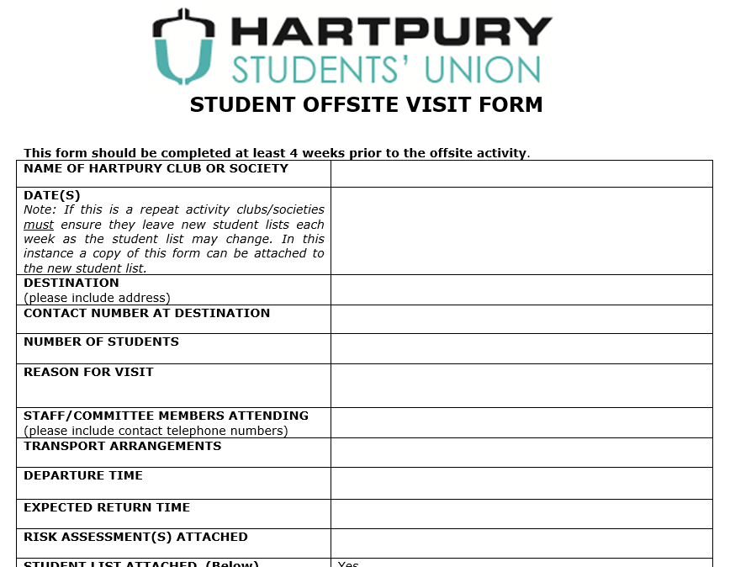
U18s procedure
Offsite visits
Risk Assessments
Transport
External Speakers
Finance
Fundraising
Social Media
Notes:
Appropriate venues / destination

Slide 16
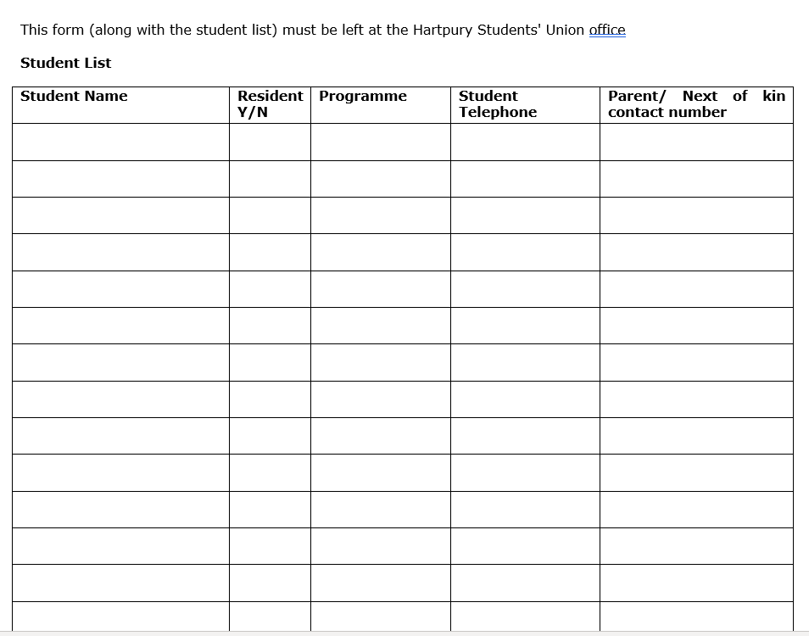
Any questions?
U18s procedure
Offsite visits
Risk Assessments
Transport
External Speakers
Finance
Fundraising
Social Media

Slide 17
Any questions?
Onsite events / activities
You’ll need to let the C&S Officer know what events you’re planning.
Booking rooms at Hartpury:
Email the C&S Officer with the following information:
Date
Time (start and finish)
Preferred room
Number of attendees
Permissions:
You’ll need permission from the building owner to host onsite activities e.g. in Legends or down at the sports academy – contact us if you’re not sure!
Legends need 1 week notice of events where food/drink consumed!
Create a risk assessment …
U18s procedure
Offsite visits
Risk Assessments
Transport
External Speakers
Finance
Fundraising
Social Media

Slide 18
Risk Assessments
External trips
Event with hot food
Event with specific physical activity
Small meeting with members
Panel discussion with external speakers
Committee meeting
Movie night
Fundraising
Debate
Large event
Please refer to the SU General Risk Assessment for all usual activity e.g. typical events on campus and fundraising.
A Risk Assessment must also be completed for any activity which goes above and beyond your usual activity e.g. a trip, event or high-risk activity
You’ll need to list everything that could go wrong (Hazards) AND how you’re going to prevent it.
If you don’t have an approved risk assessment your event CAN’T go ahead.
Risk assessment template can be found on the C&S web page on SU website.
U18s procedure
Offsite visits
Risk Assessments
Transport
External Speakers
Finance
Fundraising
Social Media
Notes:
When might we need a RA? – raise hands for yes you do!

Slide 19
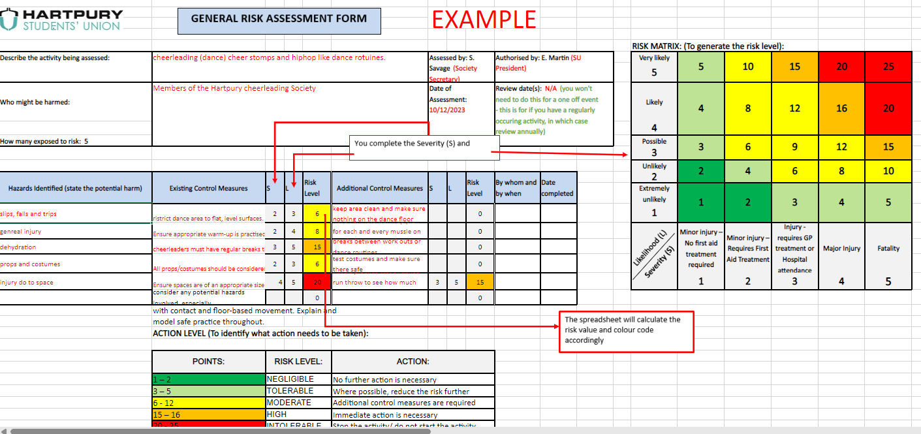
This is being updated!

Slide 20
Notes:
2 minutes – how many hazards can you count (as a committee)? (15)
Cable over table
Bag on floor – trip
Drink on laptop
Stands nearby – consider what risks might be associated there?
Fire exit blocked?
Seating – are they comfortable / supportive enough for long periods of time?
Consider what information is being given out – is it appropriate for all ages at Hartpury?
Leaflet on edge of table could fall off and cause slip
Cable behind the table plugged into the wall – trip hazard behind the desk for the people running it
Treadmill is also trip hazard
Temperature of the room – was pretty cold that day!! But these rooms can become overcrowded
Ventilation – is it too humid? Do you need to open doors / windows?
Lighting – is it appropriate / support visibility?
Poster stands quite close to edge
Safety of banner behind

Slide 21
Notes:
Same things for every single stand
Flow of traffic – appropriate?
Overcrowding is a risk
Enough seating options for people if having to wait around? – feeds into accessibility of events

Slide 22
Transport
Any questions?
U18s procedure
Offsite visits
There are a variety of transport options…
Minibus / car hire – free! (or £120 for external if none available)
Transport request form / repeat form for regular bookings
Self-drive available for students 21+ and driving 2 years
Drivers available to hire for ££.. (~£60ph)
Coach hire (expensive!)
Car share
Public transport
Risk Assessments
Transport
External Speakers
Finance
Fundraising
Social Media

Slide 23
External Speaker’s Procedure
Anyone who is not a student or member of staff here at Hartpury is considered an external speaker.
Refer to our policy in the Committee Hub
External speakers request form >
Procedure…
U18s procedure
Offsite visits
Risk Assessments
Transport
External Speakers
Finance
Fundraising
Social Media

Slide 24
It is VERY important that you submit a form BEFORE you invite anyone.

Slide 25
Any questions?
Clubs and Societies submit an ‘external speaker request form’ to the Clubs and Societies Officer at least 4 weeks in advance and BEFORE inviting the guest.
The Clubs and Societies Officer will check the form.
Information about the external speakers listed on the form should be researched online, via search engine, and any previous records of requests made to the Union.
A note of information identified should be added to the request form.
A decision is made as to whether these speakers should be referred for further investigation.
No Referral, the event is permitted to go ahead.
Speaker request referred to Students' Union Manager who will consult with the Residential Safeguarding Manager
U18s procedure
Offsite visits
Risk Assessments
Transport
External Speakers
Finance
Fundraising
Social Media

Slide 26
We need at least 1 weeks’ notice
Finance
U18s procedure
Your society account is held within the Students’ Union. We do not permit external bank accounts for societies.
Before spending any money, you must check the following;
All committee members agree on the expenditure
You have authorisation from the SU Manager
Your society account has enough funds to cover the expenditure (ask your treasurer)
The main methods of spending society funds:
Cash advance
Invoice (from the external company)
Internal transfer
Expenses claim form (claiming money back) – RECEIPTS!
Offsite visits
Risk Assessments
Transport
External Speakers
Finance
Fundraising
Social Media

Slide 27
Treasurers – listen up!
U18s procedure
Offsite visits
It is your responsibility to be aware of the finance processes involved in running the society, to advise other committee members. Please ensure you familiarise yourself with the processes in detail using the finance guide.
You will also be responsible for tracking the finances of the society throughout the year and set fundraising targets with the committee.
We’ve put together a handy budgeting tool for you… Let me know if you’d like to talk through!
Risk Assessments
Transport
External Speakers
Finance
Fundraising
Social Media

Slide 28
Fundraising for your society
We’re developing a fundraising guide!
Cash safety - bucket and money tin
Card readers
Online shop link e.g. competitions / purchases / tickets
Fundraising ideas
Photo competitions (e.g. cutest animal)
Bake sale
Car wash
Tack sale
Other competitions
Other ideas?
U18s procedure
Offsite visits
AI is a great tool for developing ideas!
Risk Assessments
Transport
External Speakers
Finance
Fundraising
Social Media
Notes:
Discuss importance of fundraising in sustainability of clubs

Slide 29
The Importances of Good Marketing and Communications
As a society you need to ensure members join and take part in your activities, and continually try and get other students to join in.
All of these require student engagement which relies on Marketing and Communication.
Ways to promote:
HSU website – Committee Hub
Screen in the loft - send us a ppt slide
HSU insta – share posts / story content with us
Share your social media logins with the C&S Officer (if not already!)
C&S webpage views:
1,685 (total) 1,082 (new visitors)
U18s procedure
Offsite visits
Risk Assessments
Transport
External Speakers
Finance
Fundraising
Social Media
Notes:
Social media – consistent posting to maintain engagement and keep same accounts as previous years to avoid confusion

Slide 30
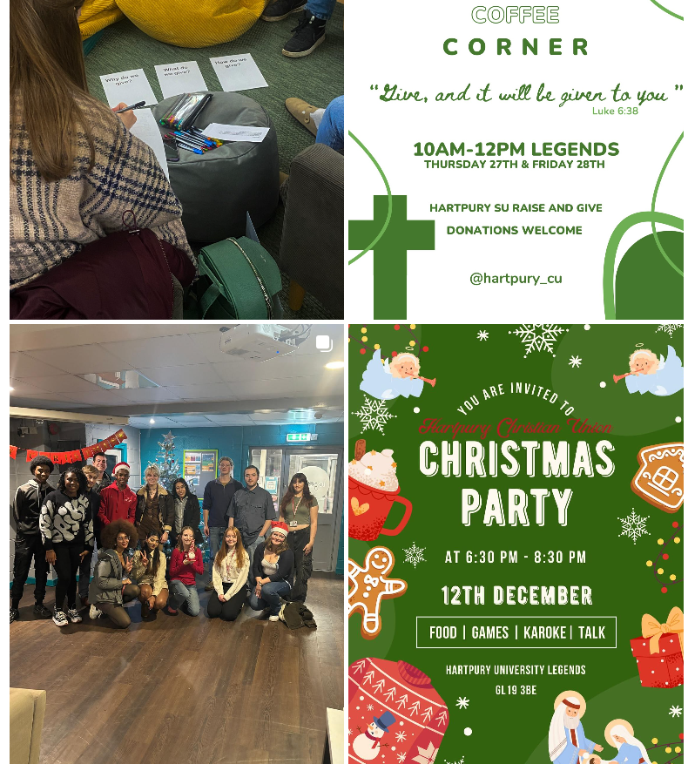
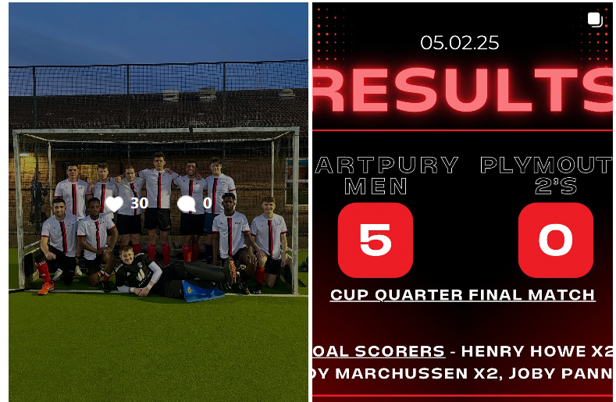
Social media rules
Any questions?
Remain professional at all times – you are representing HSU and Hartpury on your accounts.
A copy of the Hartpury Social Media guides is available on the C & S Page.
The core principles are:
No swearing/inappropriate language
Music should be radio edits only – music including profanities, reference to drugs or illegal activity should not be used
Everyone in the images/videos must be fully clothed
Never show anyone intoxicated.
Collaboration
We may share your posts, collaborate with you, or use your SU content within our reports.
U18s procedure
Offsite visits
Risk Assessments
Transport
External Speakers
Finance
Fundraising
Social Media

Slide 31
Break – 5 minutes

Slide 32
Freshers
Fair
Wednesday 17th September
11am-2pm | Legends & Lounge
Freebies
Local deals
Opportunities
Clubs and Societies
Meet Hartpury teams

Slide 33
Make it eye catching
Stand out!
Have an activity, competition or game
Provide freebies!
Wear merch (if you have it)
Banners or posters to demonstrate your club
Promote upcoming events & activities
You can have music! (not too loud)

Slide 34
Make a rota
Prepare!
Bring a link to the sign-up form
Create posters – clear contact info & social media links
Plan your key messages
Bring the A team – be confident, friendly & enthusiastic
Decide your membership fee
Remember to be sustainable!

Slide 35
Fresher’s fair checklist
Make a plan!
Complete the sign-up form to let us know you're coming (will be sent via email)
Request any items you need to purchase from your budget (include cost and a purchase link (if applicable))
Develop your own materials e.g. annual calendar / posters

Slide 36
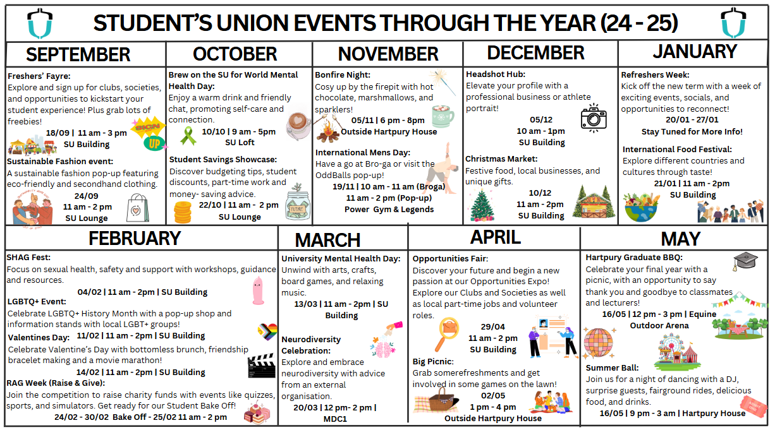

Slide 37
Planning events – quick task
5 minutes to outline 3 activities that you could run next year…
Ideas:
Zoo trip
Fundraisers – bake sale / photo contest
Craft social
Movie nights – blow up screen in the Lounge
Coffee & chats
Build a hedgehog house
Study sessions
Host a ball!
Marine mammal first aid

Slide 38
Opportunities Fair!! – YOU’RE INVITED!
29th April 11am-2pm (Sascha has sent email with more info)

Slide 39
HSU StAR Awards – in May every year
“Committee of The Year”

Slide 40
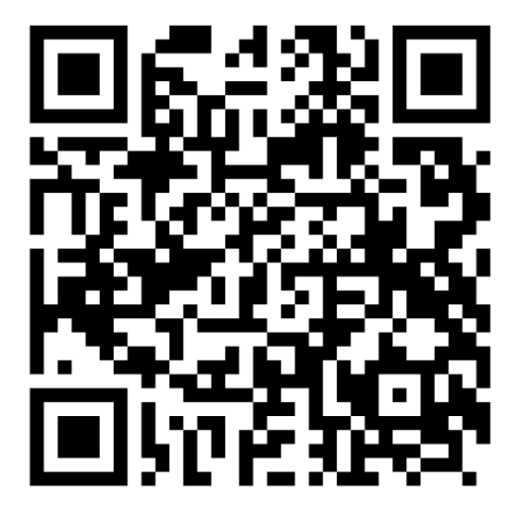
Have a look at the Committee Hub on the SU Website – all supporting docs on there

Slide 41
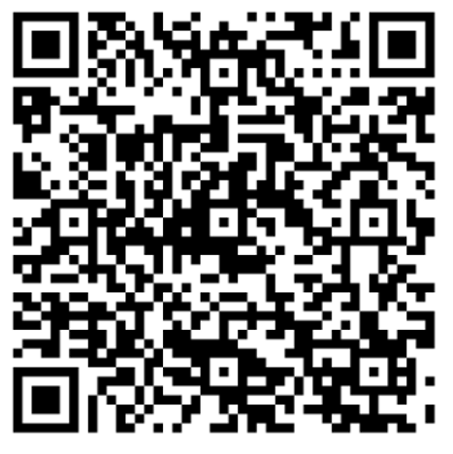
Quiz
If you’re catching up – please still complete this!

